Slide 1
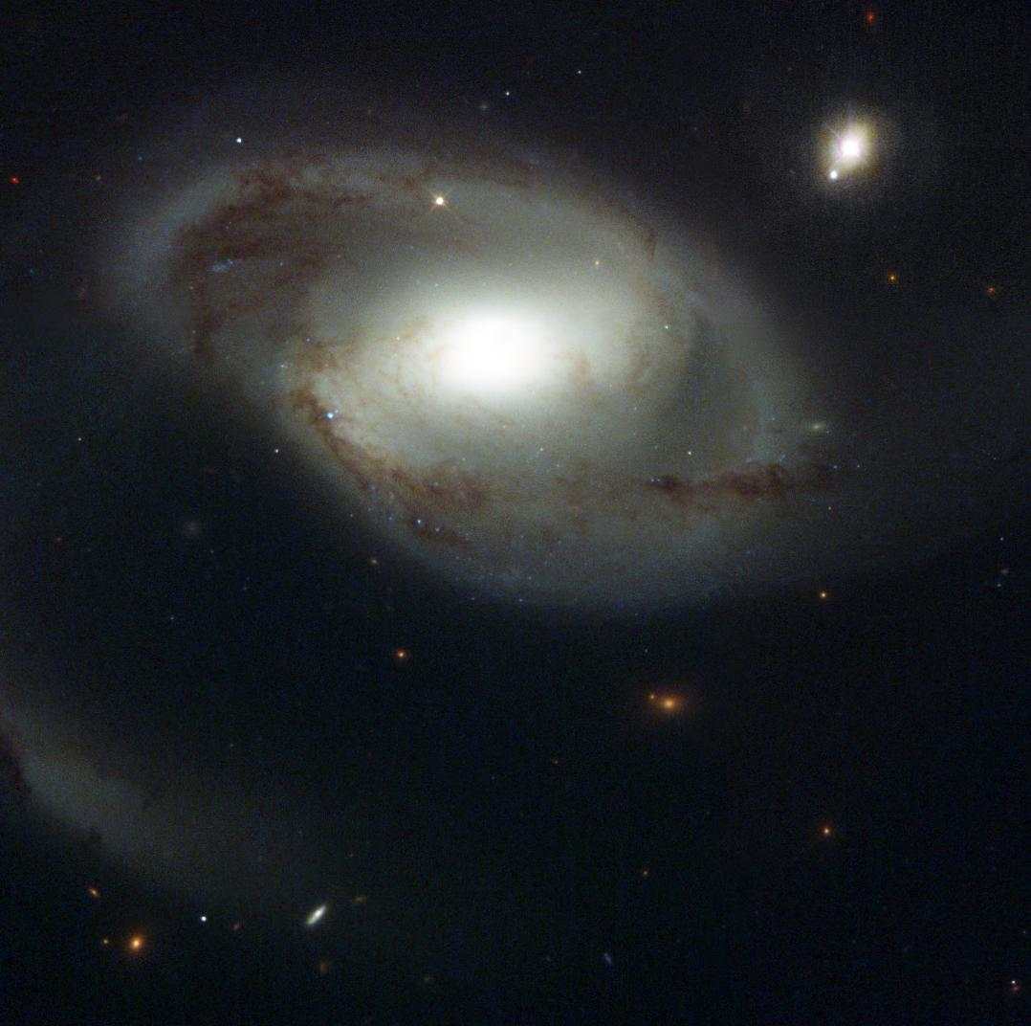
The Circumgalactic Medium of Nearby Galaxies
Does gas care about galaxies?
David M. French
University of Wisconsin - Madison
Advisor: Bart Wakker
Thesis Committee: Christy Tremonti Elena D’Onghia
Bob Benjamin
Peter Timbie
August 6, 2018
Image Credit: NASA and The Hubble Heritage Team (STScI/AURA)

Slide 2
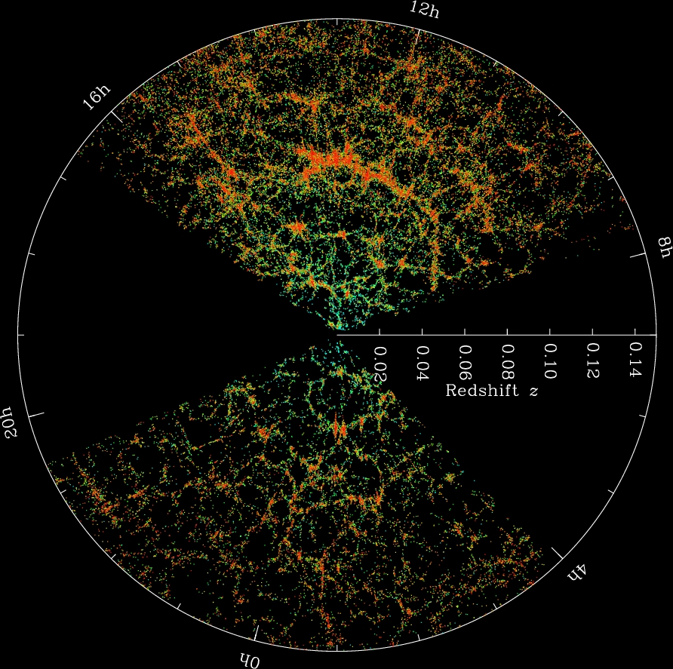
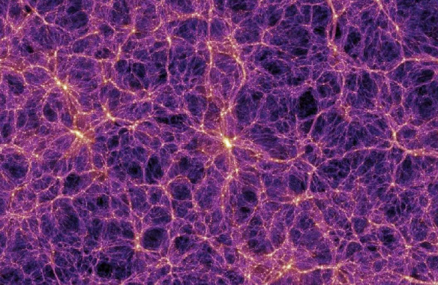
Gas + galaxies trace the same potential
The Millenium Simulation
SDSS Collaboration
Notes:
Gas collapsed with DM into filaments = cosmic web, formed galaxies

Slide 3
Does the gas care about the galaxies?
Gas and galaxies should follow the same DM potential
Galaxies need to continue accreting gas over cosmic time to match observations
Feedback kicks gas out of galaxies
How do the properties of halo gas correlate with nearby galaxy properties?

Slide 4
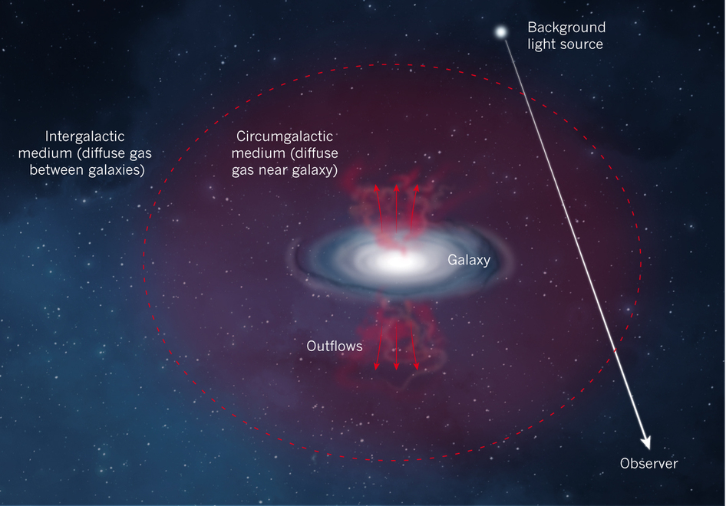
Probing the CGM with QSO absorption
Can’t uniformly sample a single halo
Must rely on serendipitous QSO locations
Build a sample of single galaxy-QSO pairs
Impact parameter and ΔV give absorber position
ΔV
Impact parameter (ρ)
Nature 517, 444

Slide 5
Science Outline
Use archival COS sightlines (~700 total)
Catalog Ly-alpha lines
Correlate with galaxy environment
IMPORTANT! Have to know where the galaxies are!
Limit search to cz < 10,000 km/s
Ask:
1. Ly-alpha EW – vs – galaxy proximity, size, orientation
2. Ly-alpha velocity – vs – galaxy rotation (co-rotation?)

Slide 6
Outline
Ch 2: A Catalogue of Nearby Galaxies
Diameters
Inclination, PA, B-band magnitudes
Ch 3: Probing Large Galaxy Halos at z~0 with Automated Ly𝛂-Absorption Matching
COS Spectra
The Likelihood Method
Inclination effect
Ch 4: Evidence for a Rotation Component in the CGM of Nearby Galaxies
SALT data (!)
Halo Rotation Model
Co-rotation fraction
b-parameter separation
Ch 5: The Environmental Dependence of Ly𝛂 Absorption
Detection Fraction
EW CDF
EW as a function of impact parameter
Inclination dependence
Azimuth bimodality
Conclusions

Slide 7
A Catalogue of Nearby Galaxies
Gather existing data
NED, IRSA, RC3, Tully (2015) Group Catalog
130,819 objects

Slide 8
A Catalogue of Nearby Galaxies
Homogenize existing data
Normalize diameters

Slide 9
A Catalogue of Nearby Galaxies
Homogenize existing data
Normalize diameters
Inclination, PA, magnitude choices
Outlier detection: Iglewicz-Hoaglin Method

Slide 10
A Catalogue of Nearby Galaxies
Homogenize existing data
Normalize diameters
Inclination, PA, magnitude choices

Slide 11
A Catalogue of Nearby Galaxies
Homogenize existing data
Normalize diameters
Inclination, PA, magnitude choices

Slide 12
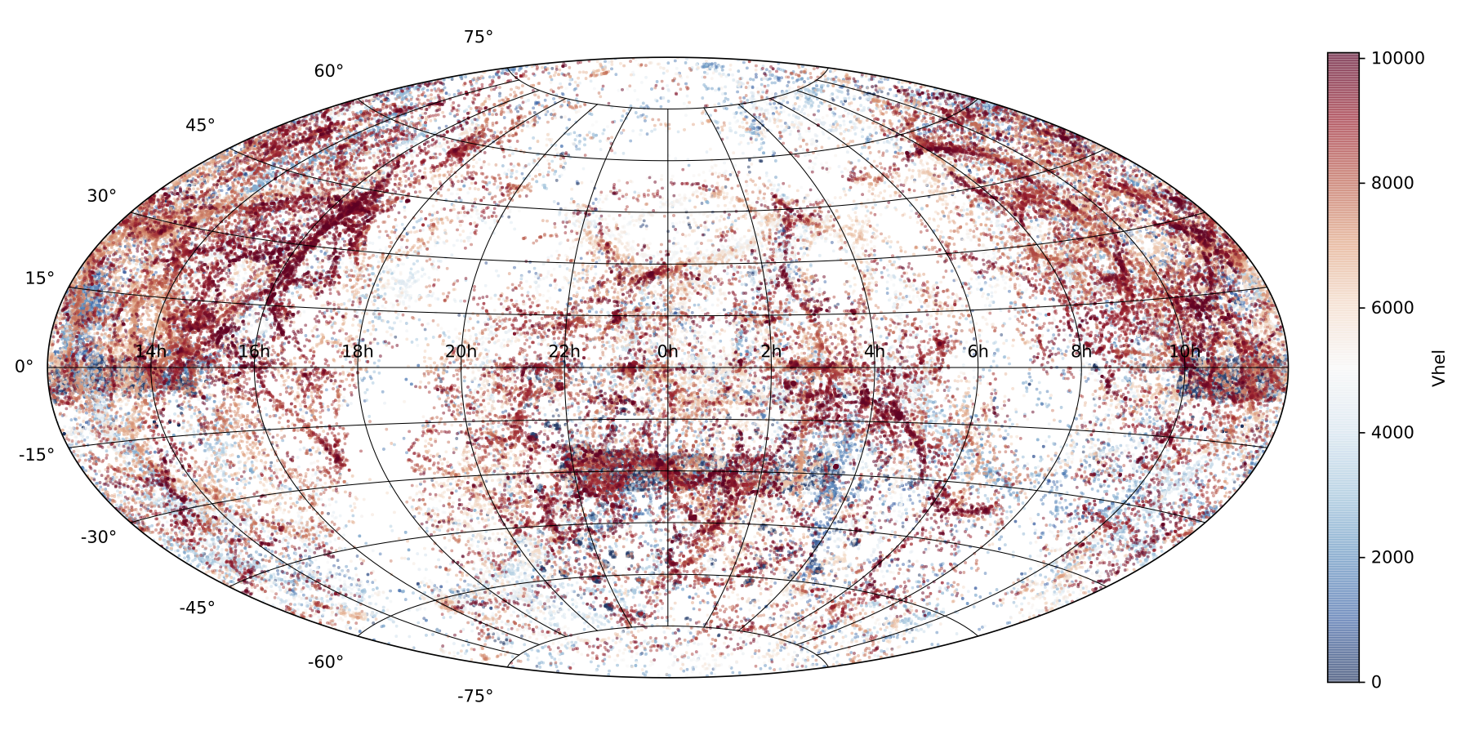
New Nearby Galaxy Catalog
Gather existing galaxy data
NED + IRSA
130,000+ galaxies with cz < 10,000 km/s
French & Wakker 2018, in prep

Slide 13
New Nearby Galaxy Catalog
Homogenize existing data
Normalize diameters, inclinations, PAs to 2MASS values
Choose representative magnitudes, calculate (L*, R_{vir})
French & Wakker 2018, in prep

Slide 14
Outline
Ch 2: A Catalogue of Nearby Galaxies
Diameters
Inclination, PA, B-band magnitudes
Ch 3: Probing Large Galaxy Halos at z~0 with Automated Ly𝛂-Absorption Matching
COS Spectra
The Likelihood Method
Inclination effect
Ch 4: Evidence for a Rotation Component in the CGM of Nearby Galaxies
SALT data (!)
Halo Rotation Model
Co-rotation fraction
b-parameter separation
Ch 5: The Environmental Dependence of Ly𝛂 Absorption
Detection Fraction
EW CDF
EW as a function of impact parameter
Inclination dependence
Azimuth bimodality
Conclusions

Slide 15
Probing Large Galaxy Halos at z~0 with Automated Ly𝛂-Absorption Matching
A pilot study with 33 QSOs
Chosen for proximity to large galaxies (D ≥ 25 kpc)

Slide 16
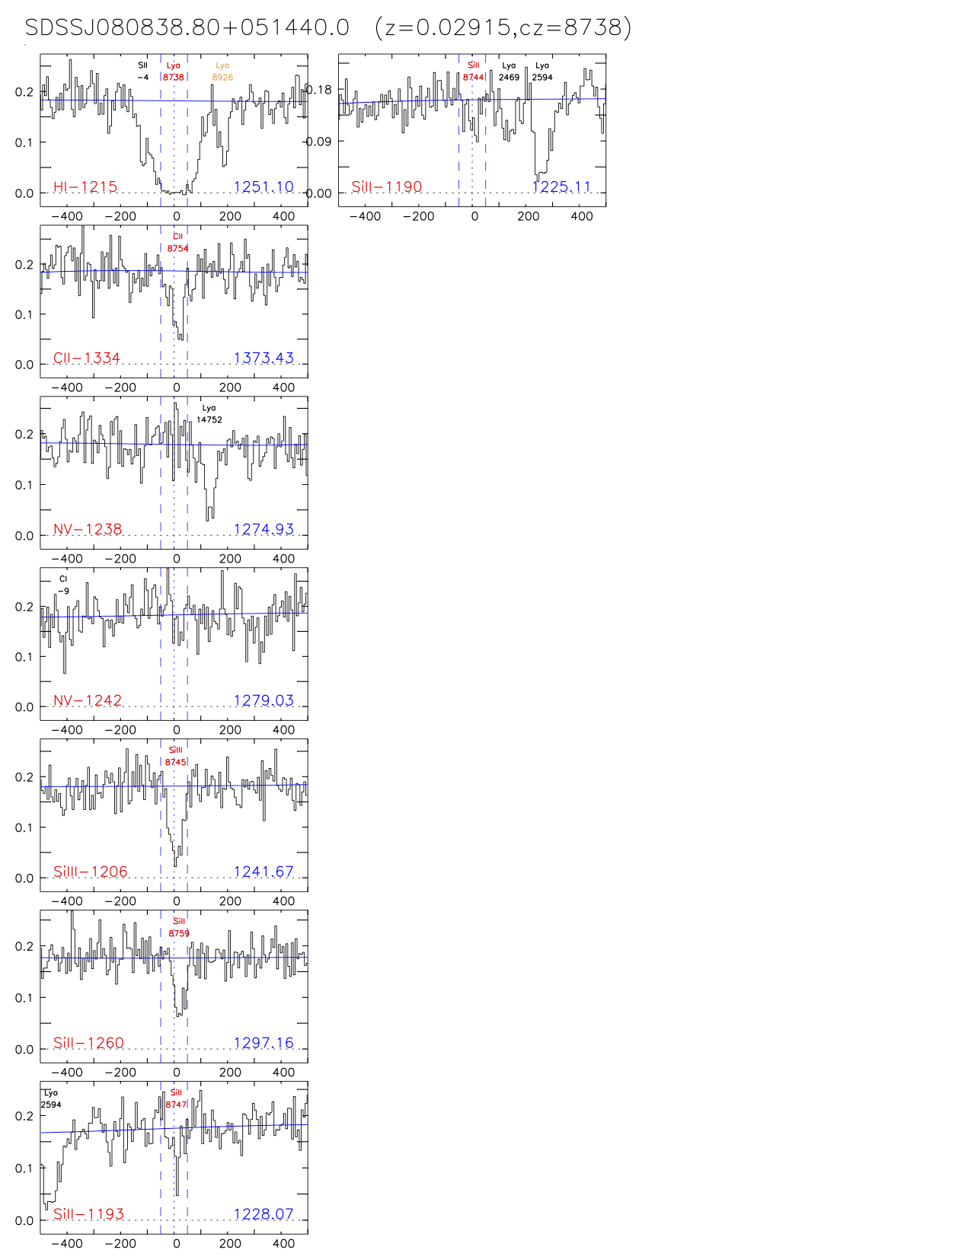
Probing Large Galaxy Halos
A pilot study with 33 QSOs
Chosen for proximity to large galaxies (D ≥ 25 kpc)
French & Wakker 2018, in prep

Slide 17
Probing Large Galaxy Halos
A pilot study with 33 QSOs
Chosen for proximity to large galaxies (D ≥ 25 kpc)
Reduce, identify, measure all lines for each sightline
French & Wakker 2018, in prep

Slide 18
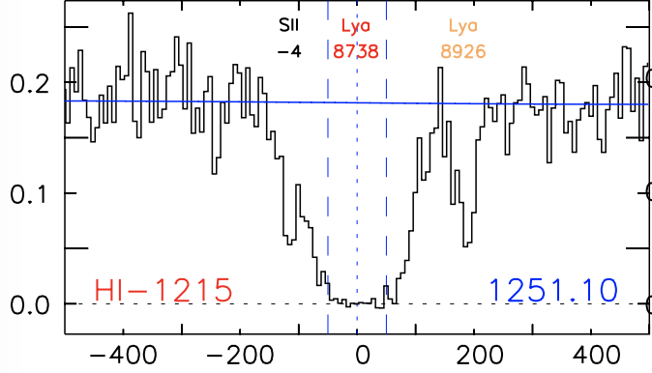
Probing Large Galaxy Halos
A pilot study with 33 QSOs
Chosen for proximity to large galaxies (D ≥ 25 kpc)
Reduce, identify, measure all lines for each sightline
Catalog all the Ly⍺
French & Wakker 2018, in prep

Slide 19
Probing Large Galaxy Halos
Matching absorbers with galaxies
Issue: Most galaxies are not isolated
Which, if either, to chose?
French & Wakker 2018, in prep

Slide 20
Probing Large Galaxy Halos
Matching absorbers with galaxies
Define “likelihood parameter”
= impact paramete
= virial radius of galaxy

Slide 21
Probing Large Galaxy Halos
Matching absorbers with galaxies
Applying the likelihood method
3D proximity indicator
Set criteria for association
= 0.00027
= 0.16
French & Wakker 2018, in prep

Slide 22
Probing Large Galaxy Halos
Matching absorbers with galaxies
Applying the likelihood method
3D proximity indicator
Set criteria for association
= 0.00027
= 0.16
French & Wakker 2018, in prep

Slide 23
Probing Large Galaxy Halos
Results!
33 QSOs – 48 Ly⍺
Matched with 33 unique galaxies (29 cases of multiple absorbers matched)

Slide 24
Probing Large Galaxy Halos
Results!
33 QSOs – 48 Ly⍺
Matched with 33 unique galaxies (29 cases of multiple absorbers matched)
Inclination preference
French & Wakker 2017

Slide 25
Probing Large Galaxy Halos
Inclination preference
Evidence for flattened, disky H𝙸 haloes?
Assuming <100% covering fraction, longer pathlength through inclined halo results in higher detection probability
Face-on
Highly-inclined
French & Wakker 2017

Slide 26
Outline
Ch 2: A Catalogue of Nearby Galaxies
Diameters
Inclination, PA, B-band magnitudes
Ch 3: Probing Large Galaxy Halos at z~0 with Automated Ly𝛂-Absorption Matching
COS Spectra
The Likelihood Method
Inclination effect
Ch 4: Evidence for a Rotation Component in the CGM of Nearby Galaxies
SALT data (!)
Halo Rotation Model
Co-rotation fraction
b-parameter separation
Ch 5: The Environmental Dependence of Ly𝛂 Absorption
Detection Fraction
EW CDF
EW as a function of impact parameter
Inclination dependence
Azimuth bimodality
Conclusions

Slide 27
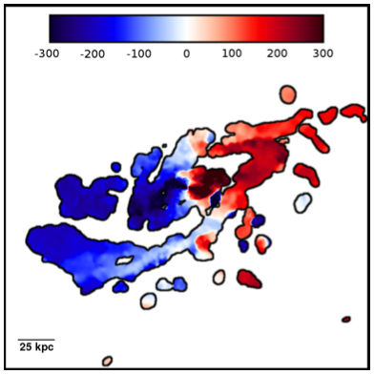
Evidence for a Rotation Component in the CGM of Nearby Galaxies
Do Ly⍺ absorbers co-rotate?
Simulations (e.g., Stewart+ 2011) suggest yes
Observations have been limited
Stewart+ 2011
French & Wakker 2017

Slide 28
Evidence for a Rotation Component in the CGM of Nearby Galaxies
Do Ly⍺ absorbers co-rotate?
What can we see with a QSO sightline?
Velocity?
V_{rotation}
Nature 517, 444
French & Wakker 2017

Slide 29
Evidence for a Rotation Component in the CGM of Nearby Galaxies
Halo rotation model
1. Input rotation curve
French & Wakker 2017

Slide 30
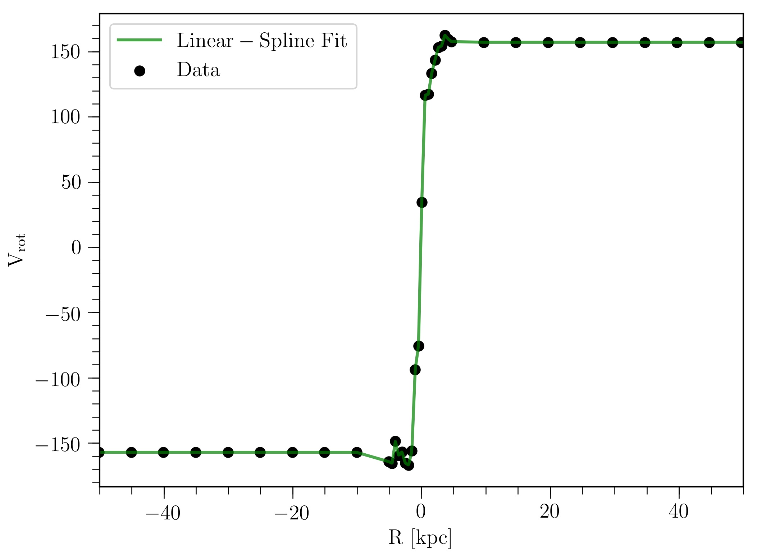
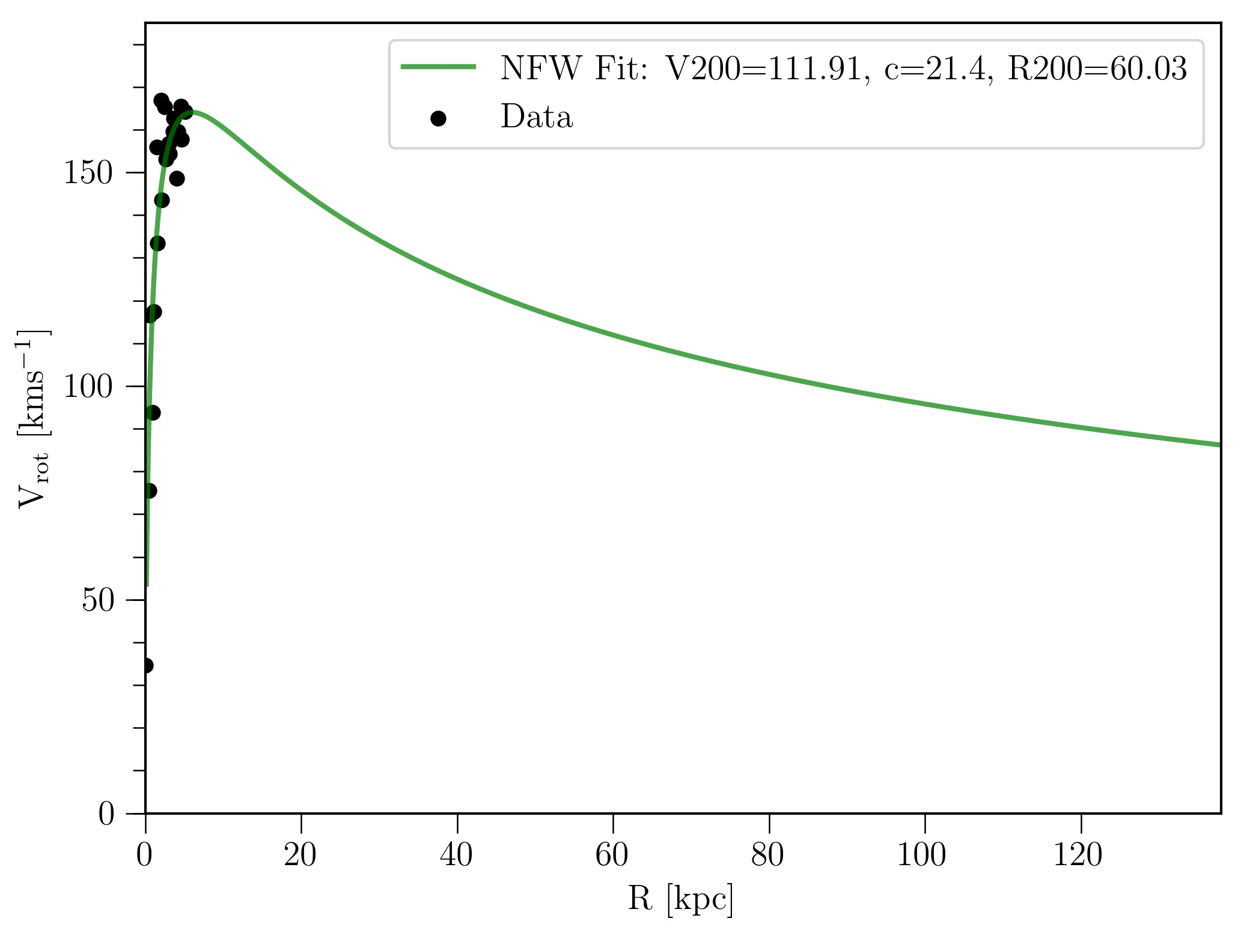
Evidence for a Rotation Component in the CGM of Nearby Galaxies
Halo rotation model
1. Input rotation curve
2. Extend via linear spline and NFW profile fits
French & Wakker 2017

Slide 31
Evidence for a Rotation Component in the CGM of Nearby Galaxies
Halo rotation model
1. Input rotation curve
2. Extend via linear spline and NFW profile fits
3. Build 3D halo from resulting profiles

Slide 32
Model sightline velocity structure
What does the sightline “see”?
Step 1: Galaxy rotation curves (H-alpha from SALT + additional from literature)
French & Wakker 2018, in prep

Slide 33
Model sightline velocity structure
What does the sightline “see”?
Step 1: Galaxy rotation curves (H-alpha from SALT + additional from literature)
Step 2: Model rotating halo based on rotation curve – project onto sightline
French & Wakker 2018, in prep

Slide 34
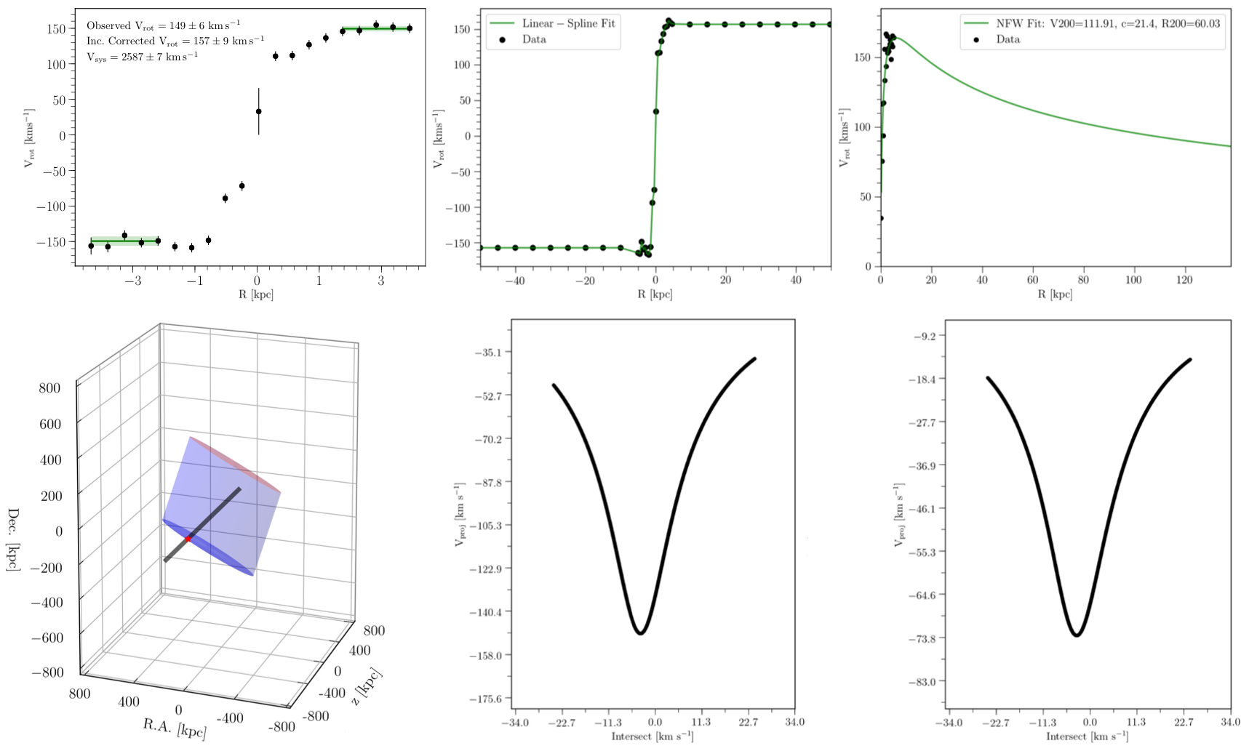
Model sightline velocity structure
What does the sightline “see”?

Slide 35
Model sightline velocity structure
What does the sightline “see”?

Slide 36
Ly-alpha co-rotation fraction
29 galaxies:
12 new rotation curves taken with SALT
17 additional from literature
41 nearby QSOs:
65 individual Ly-alpha component-galaxy matchups

Slide 37
Ly-alpha co-rotation fraction
NFW halo model:

Slide 38
Ly-alpha co-rotation fraction
NFW halo model:
43% co-rotating

Slide 39
Ly-alpha co-rotation fraction
NFW halo model:
Only include Ly-alpha with Δv = +/- v_{rot}
63% co-rotating

Slide 40
Ly-alpha co-rotation fraction
NFW halo model:
Only include Ly-alpha with Δv = +/- v_{rot}
Split around L*
1.5 L* and lower:
77% co-rotating

Slide 41
Ly-alpha co-rotation fraction
NFW halo model:
Only include Ly-alpha with Δv = +/- v_{rot}
Split around L*
0.5 L* and lower:
90% co-rotating

Slide 42
Ly-alpha co-rotation fraction
Co-rotation fraction smoothly decreases with increasing L*
Model independent

Slide 43
Ly-alpha co-rotation fraction
Co-rotation fraction smoothly decreases with increasing L*
Model independent
Evidence of cold – mode accretion?

Slide 44
Results!
Status:
224 spectra reduced, identified AND measured:
1004 Ly-alpha absorbers
French & Wakker 2018, in prep

Slide 45
EW Distributions
Status:
224 spectra measured:
1004 Ly-alpha absorbers
481 isolated (>500 kpc)
French & Wakker 2018, in prep

Slide 46
EW Distributions
Status:
224 spectra measured:
1004 Ly-alpha absorbers
481 isolated (>500 kpc)
232 isolated (but within 500 kpc)
French & Wakker 2018, in prep
French & Wakker 2018, in prep

Slide 47
EW Distributions
Status:
224 spectra measured:
1004 Ly-alpha absorbers
481 isolated (>500 kpc)
232 isolated (but within 500 kpc)
55 associated with 1 isolated galaxy
French & Wakker 2018, in prep

Slide 48
EW Distributions
Status:
224 spectra measured:
1004 Ly-alpha absorbers
481 isolated (>500 kpc)
232 isolated (but within 500 kpc)
55 associated with 1 isolated galaxy
141 associated with 1 galaxy, others around
French & Wakker 2018, in prep

Slide 49
EW Distributions
Status:
224 spectra measured:
1004 Ly-alpha absorbers
481 isolated (>500 kpc)
232 isolated (but within 500 kpc)
55 associated with 1 isolated galaxy
141 associated with 1 galaxy, others around
51 associated with 2 galaxies
”associated” with a single galaxy using our likelihood method
French & Wakker 2018, in prep

Slide 50
EW Distributions
Status:
224 spectra measured:
1004 Ly-alpha absorbers
More galaxies nearby => higher EW
481 isolated (>500 kpc)
232 isolated (but within 500 kpc)
55 associated with 1 isolated galaxy
141 associated with 1 galaxy, others around
51 associated with 2 galaxies
”associated” with a single galaxy using our likelihood method
French & Wakker 2018, in prep

Slide 51
Azimuth Dependence
Associated absorbers are bimodally distributed
Absorbers near 2+ galaxies are NOT
Major
Minor
French & Wakker 2018, in prep

Slide 52
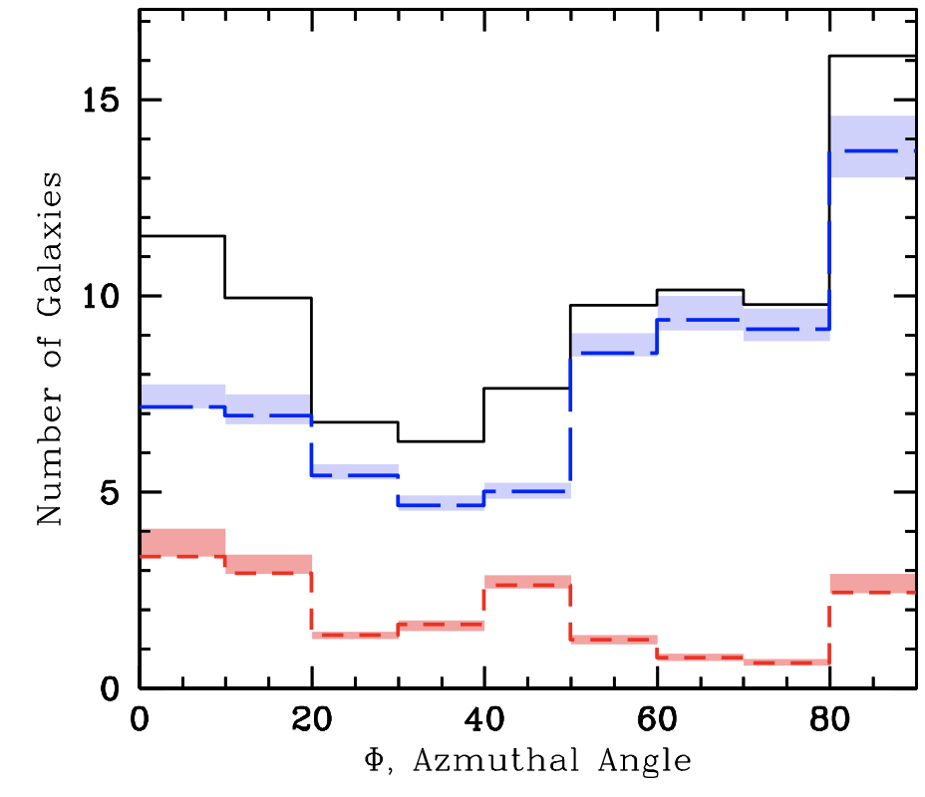
Azimuth Dependence
Similar to MgII azimuth dependence (Kacprzak+ 2012)
Shifted away from major/minor axis slightly?
Kacprzak+ 2012
French & Wakker 2018, in prep

Slide 53
Summary:
Correlating Ly-alpha from COS spectra with nearby galaxies
1004 absorbers - using likelihood method to pair with the galaxy environment
Denser environment leads to higher EW Ly-alpha
Bimodal distribution around major and minor axes
Galaxy halo kinematics
Ly-alpha co-rotation fraction anti-correlates with galaxy L* and relative distance
Evidence for halo-disk kinematic connection?
Cold – mode accretion?
Does CGM gas care about galaxies?
Yes!

Slide 54
Ly-alpha co-rotation fraction
Co-rotation fraction smoothly decreases with increasing L*
Model independent

Slide 55
EW vs impact parameter

Slide 56
EW vs velocity separation

Slide 57
Inclination overabundance
Evidence of non-spherical halo?
Covering fraction of Ly-alpha < 1
Face-on
Highly-inclined

